Slide 1
The History of Internet Peering
& The Peering Problematic
William B. Norton
Wbn (at) DrPeering.net
Belgium Neutral Internet Exchange (NBIX) Meeting
March 17, 2011
Brussels, Belgium
CellPhone
Notes:
Thank you for inviting me to speak with you today. I am thrilled to be addressing members of one of the best run Internet Exchange Points in the world. The BNIX provides a huge value to Belgium and the peering community here. And I am not just saying that. I will share some research and my calculations of the value of the BNIX for you.

Slide 2
William B. Norton
NSFNET / NANOG Chair
Equinix, 1998-2008, Co-Founder & Chief Technical Liaison
DrPeering, Founder
  Ask.DrPeering.net – DECIX Newsletter
  Consulting – GLG Expert Network, Peering Workshops
  Peering White Papers
The Peering White Papers…
Notes:
I have concentrated my effort on Internet Peering for the past 15 years.
Leading the team that deployed the first route servers, building the business plan for the commercial NANOG, the North American Network Operator’s Group – the operations forum for the Internet in North America, these are all activities that positioned me to know all of the major ISPs, their interests, their needs, their pain points.
So when I went off to California, a freshly minted MBA. I knew that I had the rolodex, but I didn’t have the knowledge. So I researched Internet Peering.

Slide 3

The Peering White Papers
Process – 1000’s of conversations
  Mindset of the Peering Community
  Speak at Conferences
  Collect data
  Primary Research
Results
  White Papers
  Web Pages
  Book-excerpts used in this preso
Some quick definitions…
Notes:
I spent 90% of my time on the road, attending and speaking at conferences around the world, very much like this one. I would ask basic questions like “hat is peering” and “how do you decide wth whom to peer?” and “How do you select Internet Exchange points”? And I would doducment what I learned, and I would walk others through what the previous people had said.
At the end of 100 walk throughs I had in my hand a paper that documented the community mindset on a previously undocumented operations activitiy. I made the papers freely available, and was invited to share them at the next operations conference.
Today I have rewritten the white papers and made them available on the DrPeering.net web page, along with all of the presentation materials, still free to the community. Besides the white papers, and the rewritten web pages, I also have a monthly ask.DrPeering.net column in the DECIX newsletter and all of this intel in book form due out in a few months.

Slide 4
Tonight
Act I – Calculating the Value of the BNIX
Act II – The Evolving Internet Peering Ecosystem
Act III – The Peering Problematic

Slide 5
Quick Definitions
Internet Transit is a business relationship whereby an ISP provides (usually sells) access to the Global Internet.
Internet Peering is a business relationship whereby two entities reciprocally provide access to each others customers.
Internet Exchange Point (IX) is an Internet service that facilitates peering between two or more entities.
Value of an Internet Exchange…

Slide 6
Value of the BNIX
VIX
Value of the BNIX
  p=44 participants
  Pvol=30Gbps
  Tp=5€/Mbps
  VBNIX=30,000*5€=150,000€/mo
Cost of BNIX
  Pcost =1000€
  44*1000€=44,000€/month
Value of the IX
Surplus Value to
Participants
Cost of Peering
f(p,t,r)
#participants
Traffic Volume
Routes
Surplus
106,000€/month
2400€/participant
ValueRatio:150/44=3.4
PBE = 1000€/5€=200Mbps
Assumptions:
Next best alternative for peered traffic is transit
5€ Transit (4€-10€ Transit Price range)
Ignoring cost of transport, colocation, equipment
Averages used. (Traffic and pricing skewed by big peers.)

Slide 7
The Evolving Internet Peering Ecosystem
All about Context
Why should we care about context?

Slide 8
My Airplane Story
NWA Flight DTW-LAX Delay→Cancel
Rebook, go to gate 34 (short walk)
On plane. Boarding disgruntles
Flight attendant: “sit anywhere”
Delayed… Palpable Anger
What happened?
Notes:
For my book, my reviewers suggested that I need a theme for my book and for each chapter as well. My theme today is context. And I want to illustrate what I mean with the following story.This happened to me, but I want you each to take a deep breath and pretend you are in the situation. I will ask you what you would have done.
You are at the airport waiting for you flight from Detroit to Los Angeles. The gate agent calls for you to approach the gate where she infors you that thte already delayed flight will most likely be cancelled and that she has rebooked me on the next flight to LA, about 10 gates down the terminal. I ask that my colleagues be rebooked with me and she abliges, then the three of us get onto the new plane, just in time for it to depart. Or so we thought.
The flight didn’t take off on time. We witnessed clearly agitated people getting on the plane, disheveled, out of breathe boarding. These people were clearly distressed. After a dozen or so got on, several came back to the front saying their seat was taken and plopped down in first class. The flight attendant said “OK just sit anywhere we have to leave.” The door closed and we took off, but not before I heard the horrible situation at the gate.

Slide 9
What happened?
Back at gate
Flight was Cancelled
“Room for 15-20 passengers”
“Proceed in orderly fashion”
“Will handle as many as we can”
154 people hauled
Line → special case override → Mob Scene
Get the yellers out of the line
Aggression, pushing, shoving, many cops called
Notes:
As it turned out, shortly after we had left, the gate agent indeed annoucned the cancellation of that first flight. She made the following announcement:
“Ladies and gentle, we regret to inform you that flight 234 to Los Angeles has been cancelled. We will work to rebook you on a later flight, but in the meantime, we have a flight to LA leaving in 10 minutes at gate 34, about a 5 minute walk from here. We can take about 12-15 of you. If you would please progress to gate 34 in a calm and orderly fashion we will handle your rebooking there.”
Given this context, can you guess what would happen? Is it not predictable what would happen?
Sure enough, the line developed at gate 34 and the gate agent processed people in order until people sarted circling round to state their special case. “My band plays tonight”, “I am already late to my sisiters wedding”, “My busines meeting starts after I land”, “I can not be late”, etc. The orderly line of processes turned into a “make your case” mobfest. The notion of fairness, engraved in our minds, kicked in and led to the airport and detroit cops being summoned to the gate to calm things.
Whose fault is this? Before you state the obvious, that the airline is responsible, do you place any blame on the flyers? Do they not have control of their actions? Or are we wound up like an involunatry muscle forced to act even if we do not know why.

Slide 10
Who is responsible?
Airline vs. Passengers
Show of hands
  ___ Airline 100% Passengers 0% responsible
  ___ Airline 90% Passengers 10% responsible
  ___ Airline 80% Passengers 20% responsible
  ___ Airline 70% Passengers 30% responsible
  :
Does Context drive Behavior?

Slide 11
The Peering Problematic
Evolving Internet Peering context
  Positional power
  Predictable Behavior
This is a talk about the future of peering
  Trajectory from the past
Discussion Paper

Slide 12
History of Internet Peering Contexts
ARPAnet
Access Powers
NSFNET
TRANSITION
COMMERCIAL
Fat Middle
1987-1994
1994-1997
1998-2002
2000-2009
2009→
Morphing
Notes:
This is a talk about the evolution of Internet Peering, the context that ISPs operated within over the years.
This is so interesting to me because these disparate players, interconnected and expanding organically are morphing as if they were part of a living organism.

Slide 13
1st Peering: ARPANET 80’s
USENET/BITNET/X.25 could not connect
ARPAnet limited to gov’t & contractors
CSNet-NSF project to connect all CS depts
Spotlighted AUP problem
Bureaucratic complexity
  Settlement of financial, admin, contract etc.
Peering is “interconnection without explicit accounting or settlement”
Source: http://www.interisle.net/sub/ISP%20Interconnection.pdf
http://drpeering.net/AskDrPeering/blog/articles/Ask_DrPeering/Entries/2010/10/22_Origins_of_Internet_Peering.html
Notes:
In the early 1980’s the ARPAnet was restricted to government and government contractors, and commercial networks could not connect. The NSF sponsored the CSNet project to interconnect the computer science departments together which ultimately highlighted a problem.
Both sides assumed there was enormous complexity involved in reconciling the different network AUPs, and that the corresponding settlement adminsitrative and contractual issues associated with interconnection were formidible.
This is where peering was first invented as “interconnection without explicit contracts”
Q: What were the origins of Internet Peering? When was the first peering agreement?
George Costanza
A: I came across a very nice white paper from Lyman Chapin the Interisle Consulting Group that described the story far more eloquently than I could so I will simply quote the relevant two paragraphs and encourage you all to read the rest of his Interconnection and Peering among Internet Service Providers - A Historical Perspective paper:
The relevant section:
“2.3.2 CSNet and NSFnet
The USENET, BITNET, and commercial X.25 networks could not be connected to
the ARPAnet (or to the other federal networks that were interconnected at the
FIXes) because of the government policy limiting ARPAnet to government
agencies and their contractors. The turning point that eventually brought them
all together was the CSNET project, which was created in 1981 under a grant
from the National Science Foundation . The purpose of CSNET was to link all of
the computer science departments and industry labs engaged in computing
research. It provided TCP/IP interfaces with USENET, BITNET, and the X.25
networks, and established nameserver databases to enable any computing
researcher to locate any other.
The development of CSNet highlighted the disconnect between the “haves” and
the “have nots” in the computing research community—between those who
could find a government agency or contractor to sponsor their connection to the
ARPAnet, and those who could not (connecting instead to CSNet). In modern
terms, we would say that the customers of one ISP (ARPAnet) could not
communicate with the customers of another ISP (CSNet), because no mechanism
existed to reconcile the different Acceptable Use Policies of the two networks.
This disconnect persisted as both sides assumed that any agreement to exchange
traffic would necessarily involve the settlement of administrative, financial,
contractual, and a host of other issues, the bureaucratic complexity of which
daunted even the most fervent advocates of interconnection—until the CSNet
managers came up with the idea that we now call “peering,” or interconnection
without explicit accounting or settlement. A landmark agreement between NSF
and ARPA allowed NSF grantees and affiliated industry research labs access to
ARPAnet, as long as no commercial traffic flowed through ARPAnet. This
agreement was the turning point at which the evolution of commercial network
interconnection began.”

Slide 14
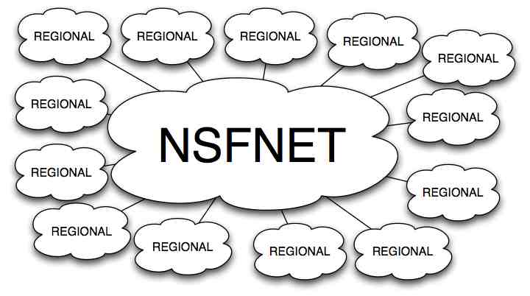
NSFNET – ‘87-’94
Core
Open Regional Techs Meetings
NSF sponsored attachments
Growth→Time to privatize
Notes:
I worked on the NSFNET at the beginning of its contract with Merit Network. The NSFNET was the core of the Internet, with the task of interconnecting the NSF-funded regional networks together. This way the researchers at one supercomputing center could share data with researchers at another supercomputer center for example. The attachments were the regional networks and we maintained a database for keeping track of who was authorized to connect to the backbone.
It was at this time that the Regional Tech’s Meetings were born as well – we met a few times a year to share how the NSFNET was doing and the regional network techs shared what they were seeing This was a true and open cooperative activity.

Slide 15
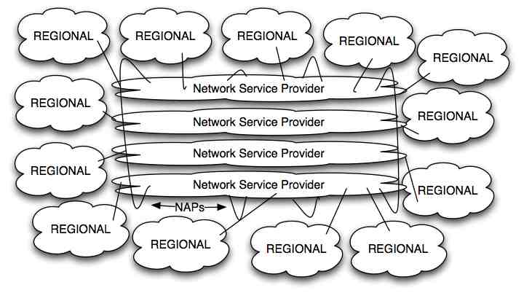
NSFNET Transition – ’94-’96
Strong NANOG Chair model
Interconnect a private matter
Chair & commercial interests
PacBell NAP
AADS NAP
MAE-East*
Sprint NAP
Notes:
Around 1994 the NSF recognized that the Internet need not have the gov’t operate its core and assembled a team of key stakeholders to design a transition architecture to maintain the connectivity for the regionals while allowing the commercial ISPs to compete for the contract. The resulting architecture is shown here.
The NSPs competed for the regional network business but had to interconnect at the NAPs. My role was to likewise come up with a plan to commercial the regional techs meetings, now called NANOG Meetings. I came up with the business plan for doing that and called myself the NANOG chair, assembling the meetings, the speakers and topics, introducing the speakers, etc. with the help of some fellow Merit staff and volunteers from the community..

Slide 16
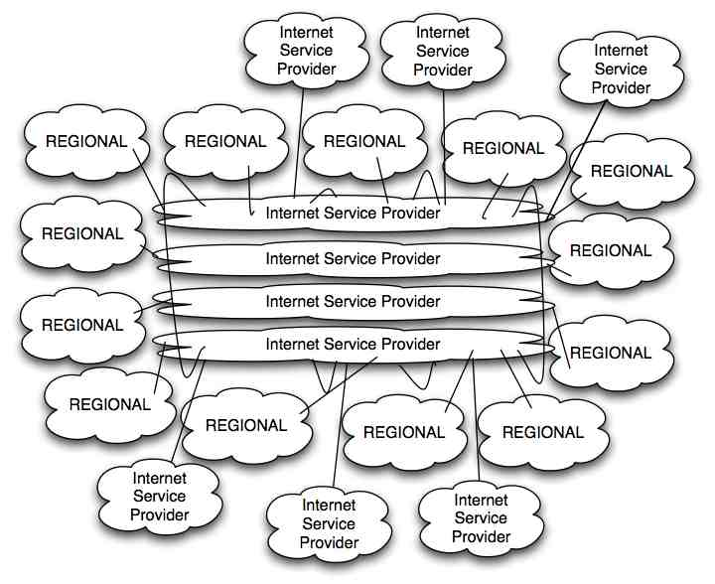
Commercial Internet – ’96-’98
NAPs=“Congestion Points”
→Private Peering
Resale & Growth
Little visibility/sharing
Notes:
The Internet continued to grow and there was a massive growth in the number and type of ISPs now reselling access to the Internet. The shared ATM-based peering fabrics at the NAPs became congestion points and the large Tier 1 ISPs connected to each other using point to point circuits.

Slide 17
Tier 1 Club Private Peering Migration
Metro-Area Circuits
Tier 1 ISPs abandon NAPs
Congestion at NAPs
NAPs run by competitors
Reduce complexity – fiber breaks less often than active electronics
Full Mesh in each of 8 interconnect regions across the U.S.
Notes:
Congestion at the NAPs, referred to as “congestion points” by detractors, led to a migration to private peering by the Tier 1 ISPs around 1998.
The fact that the NAPs were operated by competitors provided additional business motivations to make the architectural transition for the Tier 1 ISPs. The other force was the desire to not use one’s own NAP – the UUNet ISP for example loathed to peer at MAE-East, a wholly owned subsidiary.

Slide 18
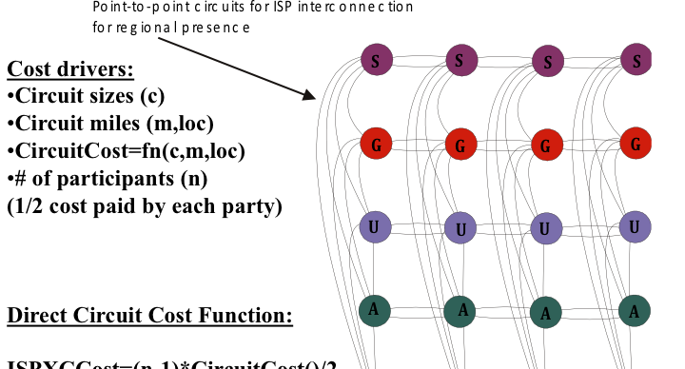
2000-2001
Carrier Neutral Internet Exchange Points (PAIX/EQIX)
Proved financially better if at least 5 Tier 1’s build in and do fiber cross connects

Slide 19
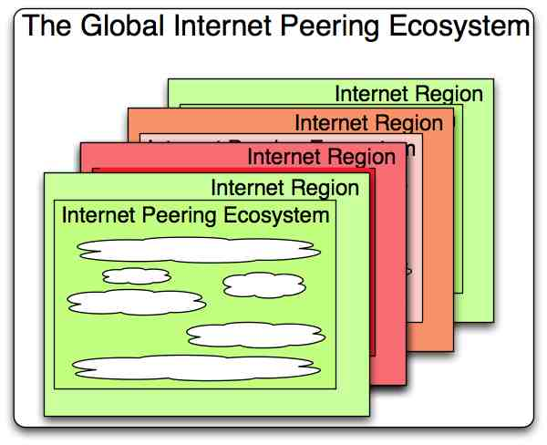
Commercial Internet
Internet Growth
Organic
But evolved
With structure:
Notes:
The Global Peering Ecosystem is a containment abstraction that helps us understand Internet Interconnection dynamics.
The Internet is composed of a set of Internet Regions, usually loosely associated with countries.
Each Internet Region contains an Internet Peering Ecosystem that contains a set of network service providers interconnected in some business relationhiops.

Slide 20
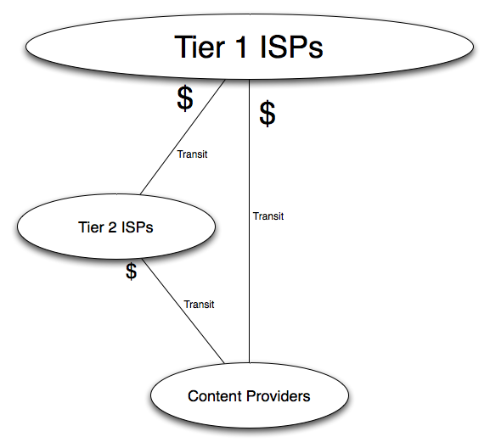
Basic Internet Peering Ecosystem
Tier 1 ISPs have access to
The entire Internet Region routing
Table solely via their free peering
Interconnects.
They do not pay transit fees to
reach any destination in their
Internet Region.
Revenue and traffic flows to T1s.
Tier 2 ISPs are everyone else.
Pay transit fees.
Interested in peering around
transit providers.
Attend Peering Fora
Notes:
I have studied dozens of Internet Regions around the world and they all tend to have at least these categories of participants in the Internet Peering Ecosystem. The Tier 1 ISPs have access to the entire regional routing table solely through their free peering relationships. The Tier 2 ISPs are different in t that they need to purchase transit from someone in order to reach some destinations within the Internet Region. They have the motivation therefore to peer with each other to reduce that transit expense. The content providers differ in that they generally do no t sell Internet Transit, don’t tend to have a backbone or even much of a network engineering team.
The Tier 1 ISPs are in a good position, aren’t they? All traffic in this picture goes through them, and they get paid by the eyeballs that request the content, or the content that connects to them or even perhaps both.
Note however that gouging didn’t occur here, because there were usually multiple Tier 1 ISPs completing for business, and there was also the opportunity to peer with the Tier 2 ISPs that could reduce the transit load. There were two alernatives for getting content to the eyeballs- competive transit and peering.
But from 2000-2002 we saw a morphing of the ecosystem, a system that had adverse effects on the Tier 1 ISPs..

Slide 21
Fat Middle Peering ’00-’10
New Players
@home bankrupt
CDNs
LSNSCP
“Open” Peers
:
“Selective Peers”
Peering decreases T1’s transit fees
Growth increases at a faster rate
Notes:
The middle of the Internet Peering Ecosystem got fat. The cable companies in the U.S. came into the peering ecosystem as “open Peers”, willing to interconnect with anyone for free provided there was enough traffic to make it worth while. The largest content companies got into peering to improvie and control the end user experisnce. This was a universal motivation for content companies – they wanted to save money yes, but #1 was the end user experience. And of course, just as the Tier 2 ISPs peered with each other, the cable companies peere with each other This resultied in a maasive shift of traffic away from traversing the Tier 1 ISPs.

Slide 22
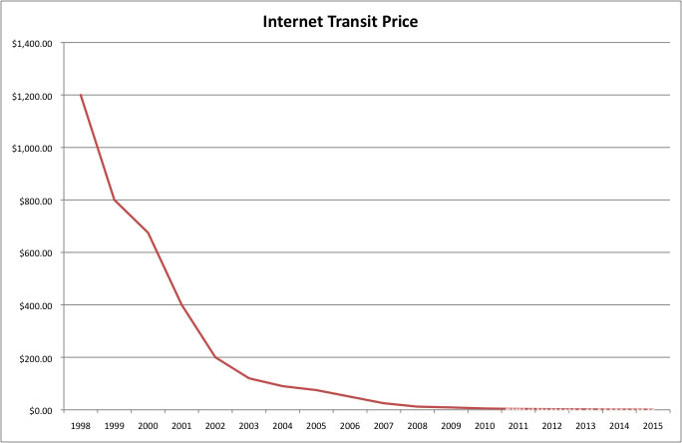
Key Trends: Transit Prices Decline & Video Emerges
Video 2010: 40-50%
Source: discussions with ISPs
Video 2013: 80%
Source: Cisco
Notes:
As a result the price of transit dropped precipitously.

Slide 23
Captive Access Power Peering
Notes:
The cable companies (mostly Comcast at this stage) started exploiting the fact that there is only one way to get to the eyeballs – through the cable company network! They installed a peering ratios prerequisite so that any entity that sent more traffic to the cable company than they received would not qualify for free peering. Since Comcast customers are predominantly eyeballs, pulling down content from the Internet, very few candidates had a balanced ratio to offer. So Comcast created a peering policy that led to revenue from paid peering. For over a decade I had been searching to understand and document aid peering and finally I had found it. Here is how it works.

Slide 24
Captive Access Power Peering
Comcast-Level 3
Disclaimer: The facts here have not been verified.
This is for discussion purposes only.
The Comcast-Level 3 – NetFlix situation is used because it is
a very public example that illustrates the power positions

Slide 25
Captive Access Power Peering Example
Level3 broad business deal
Fiber, transit, free peering (on-net), etc.
3 Ways to reach Comcast
Transit (A→GLBX→Comcast)
Paid Peering (A->Comcast)
Peering (A->Comcast) w/vol & <2.5:1
Video is highly asymmetric up to 30:1
Comcast peering ratio requirement<2.5:1
All paths require Comcast
Peering is direct, high performance
Transit is subject to loss/latency
OTT Video requires high performance
No alternative path to Comcast eyeballs
but through Comcast (Captive customers)
If you are in the video distro biz you must buy paid peering from Comcast
TATA
$
T
$
T P
$
T
$
T
Notes:
Today we are seeing the emergence of a new power player in Comcast. The positional power is based on the fact that the eyeballs that consume Internet traffic are “Captive”, only reachable via a path through Comcast. We need to explore a couple of other key aspects to this network situation.
A content company or content distributor has two choices for getting its content to the eyeballs. It could purchase transit and its upstream provider would get the traffic to the eyeballs. The alternative is to peer with Comcast. Comcast has a peering prerequisite of a haelthy chunk of traffic, but that isn’t what disqualifies most prospective peers form free peering with Comcast. Comcast requires a traffic balance of less than 2.5:1.

Slide 26
1) NetFlix Application 2010
NetFlix distributes Video via CDNs
Massive growth
O(100’sGbps)
Great Service
$
T
$
T

Slide 27
2) Level3 Bids Cheaper
Akamai loses T$
Comcast loses PP$
Level 3 freely peers the traffic
Level 3 requests more interconnects
Comcast says No – you pay like AKAM&LLNW
Level 3 Acquiesces
Access Power Peering
Comcast says (in essence) “We have others paying us.
It wouldn’t be fair not to charge you as well”
Note: The Level3-Comcast relationship
could be argued to not be a true peering
relationship as there is asymmetric exchange.

Slide 28
3) Result & Observation
Comcast leverages peering to get $$ from all sides
No alternative to reach Comcast customers
“Captive” Customers
Can’t peer around them
Can’t choose competitor
Exploiting Market power position: Captive Market
Where is this going?
Is this the right model?

Slide 29
Provocative Solution

Slide 30
Ban Captive Access Paid Peering
Access Networks with Market Power should only be allowed to sell in one direction (inbound or outbound).
Broad Strokes
  Pick a direction and charge that direction
  Either charge the ingress or egress, but not both

Slide 31
Why complain now?
Tier 1 Model
Power Access Model
$ goes to Tier 1 ISPs
Alternatives
  T1 Competitors are comparable alternative
  T2-T2 Peering bypass T1
  Aligned group interest
  Leads to efficiency (n(n-1))
Leverages Performance (scope, scale, speed, reach)
Leads to efficiency, lower transit in competitive market, peering applies downward pressure
$ goes to Access
  No comparable alternative
  No Free Peering bypass
  Paid Peering required
  Benefits Comcast
  Content-Access efficiency
Leverages Captive Market (customer base)
Leads to efficiency if you pay access
Too much power in hands of one player

Slide 32
Does Context Drive Behavior?
If Captive Access Paid Peering is allowed, what prevents paid peering price escalation?

Slide 33
Acknowledgements
Thanks to Frédéric Libotte (BNIX), Pierre Bruyère (BELNET), Jon Terreele (BELNET), Scott Landman (JetStream), and many anonymous discussions.

