Slide 1

The Art of Peering: The IX Playbook
Needs work – follow the white paper sections and insert the image files
William B. Norton
Executive Director
DrPeering International
11-12 August 2010
Nairobi, Kenya
Sarova Panafric Hotel Nairobi
African Peering and Interconnection Forum: Unlocking Africa’s Regional Interconnection

Slide 2
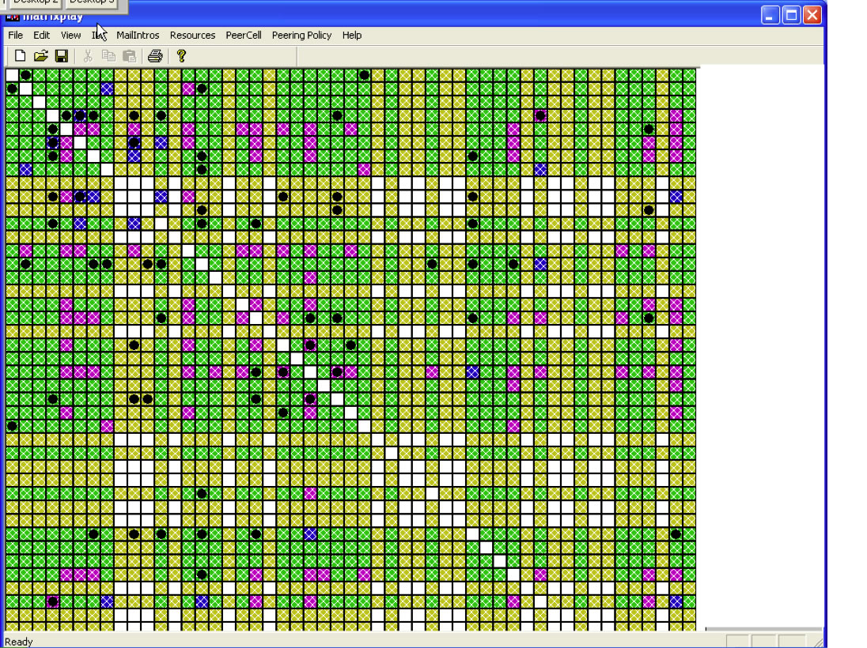
Peering Matrix

Slide 3
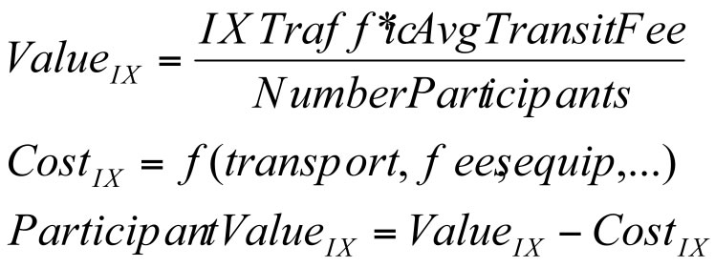
Value of IX

Slide 4
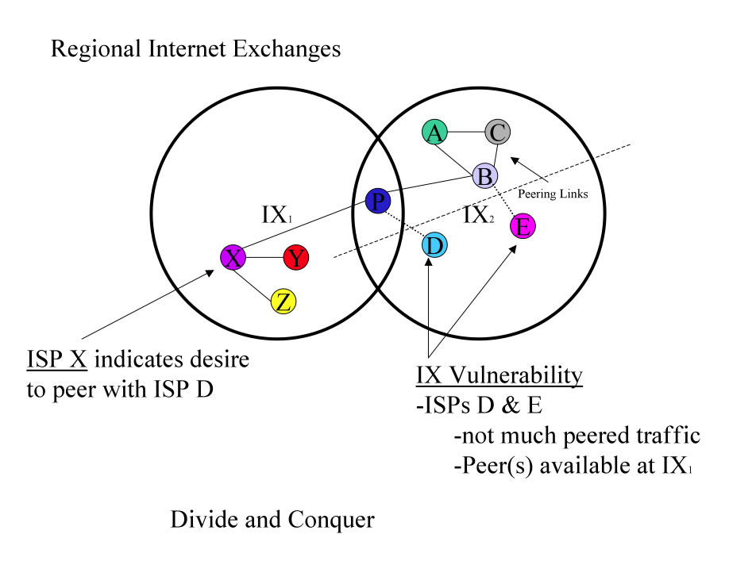
Divide and Conquer

Slide 5
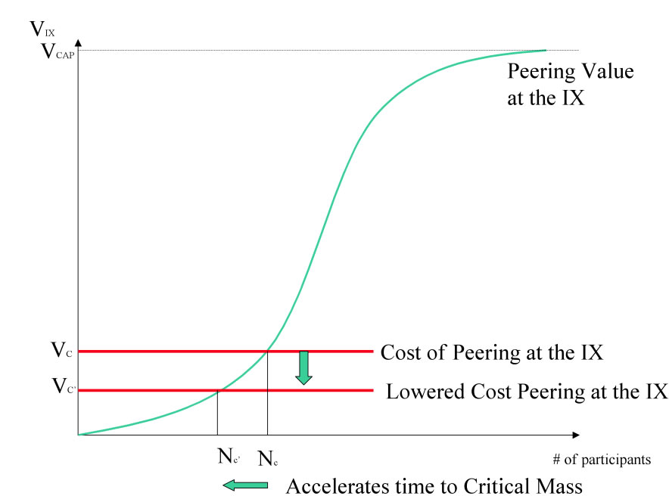
Drop Prices

Slide 6
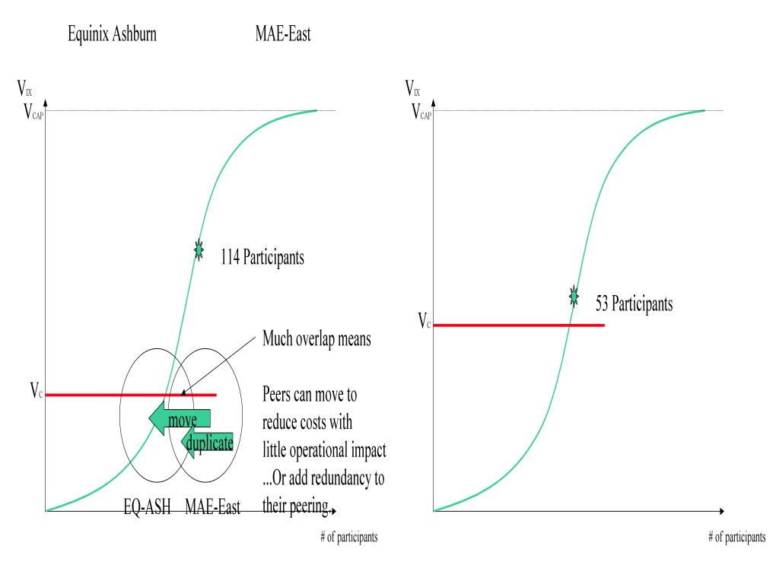
EQIX vs MAE-East

Slide 7
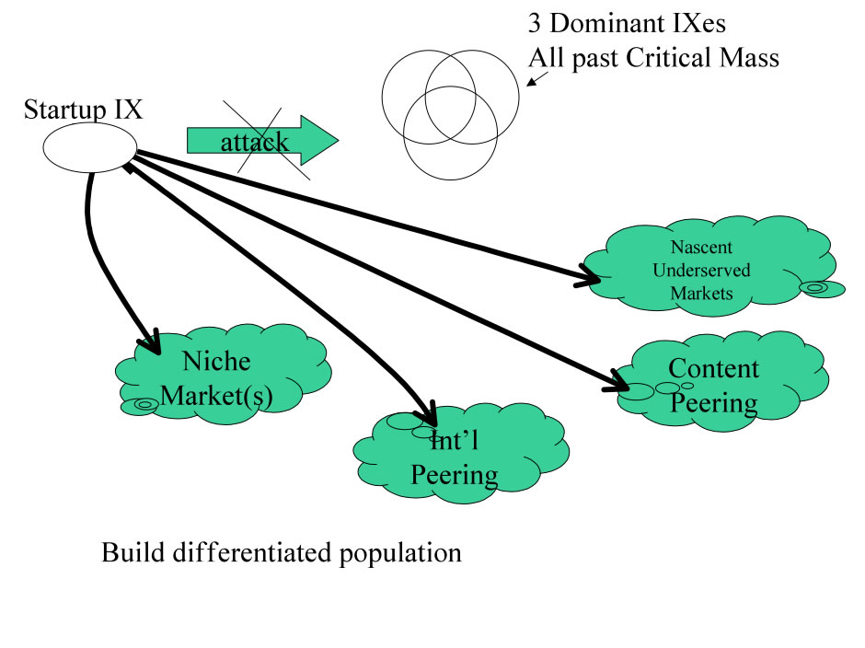
Evade and attack Weakness

Slide 8
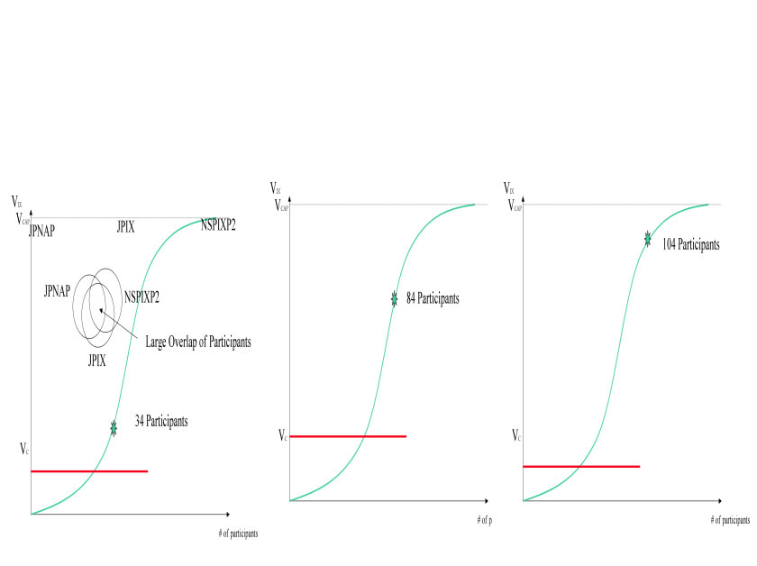
JP Competitive Map

Slide 9
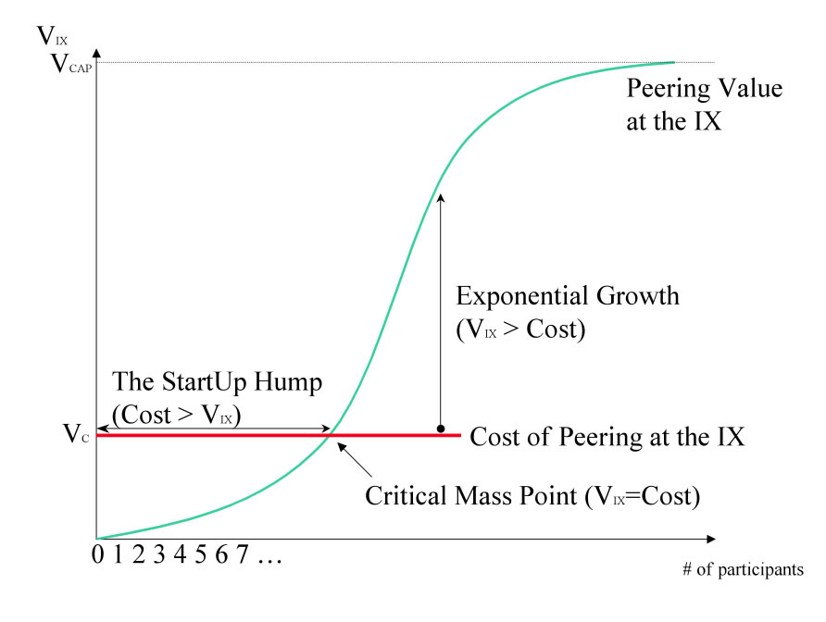
Network Externality

Slide 10
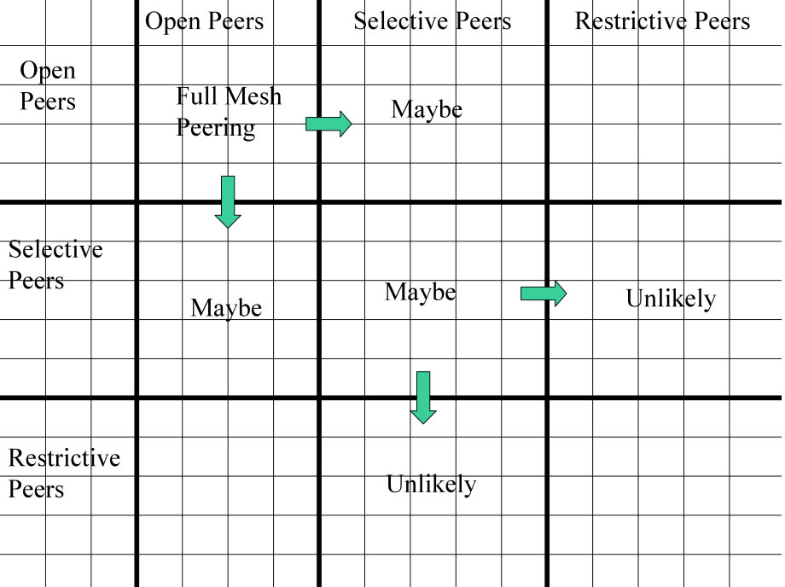
Peering Matrix

Slide 11
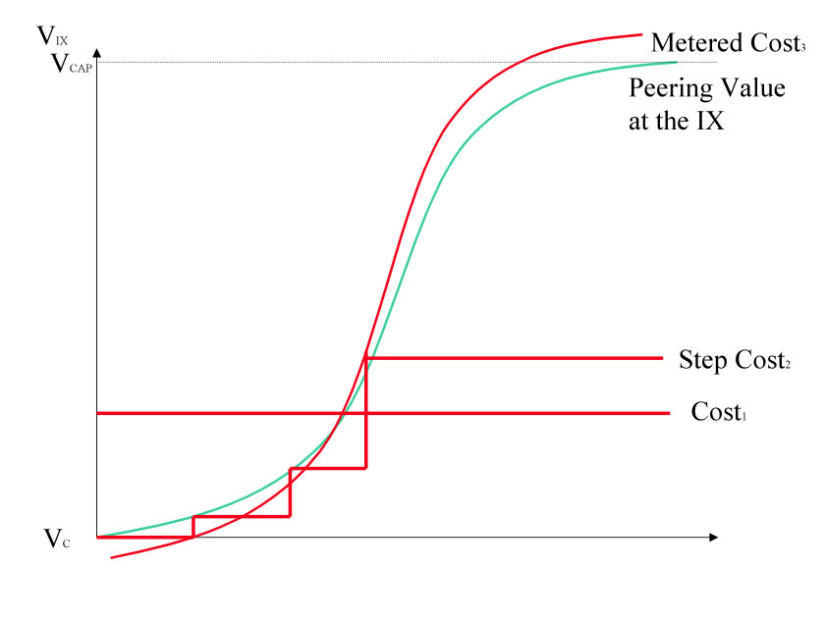
Price to Value

Slide 12
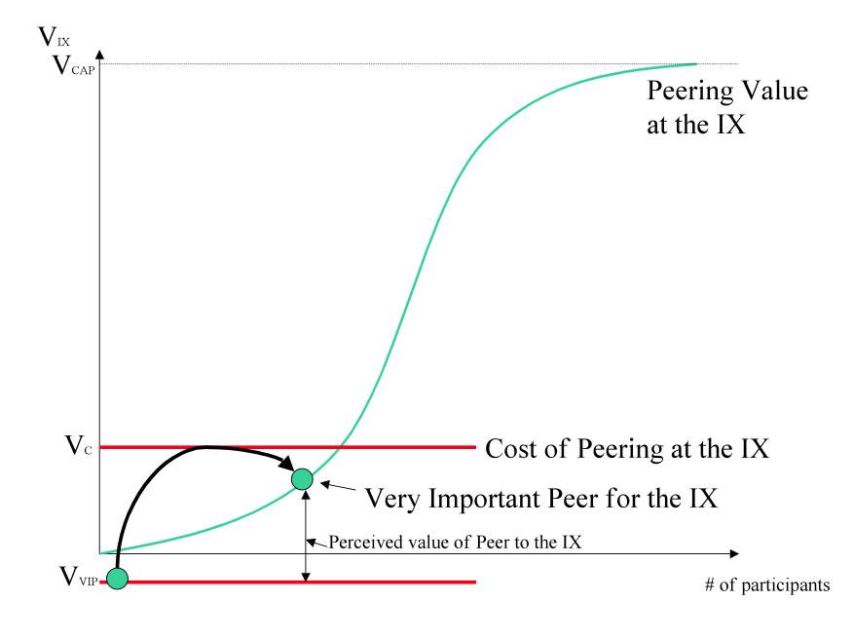
Buy in Peers

Slide 13
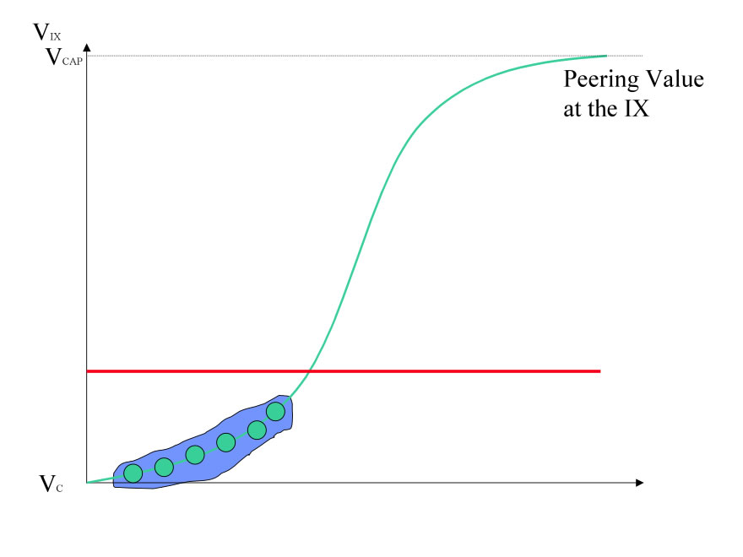
Group Buy in

Slide 14
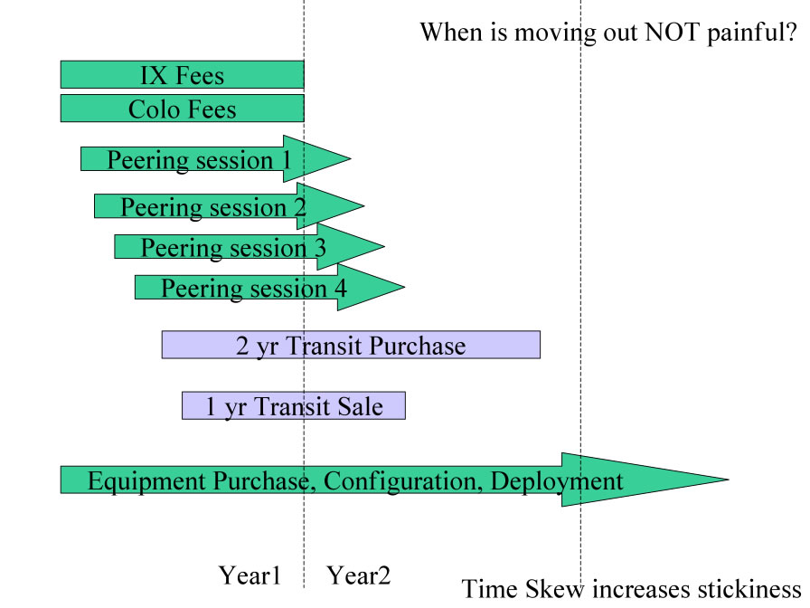
Time Skew Stickiness

Slide 15
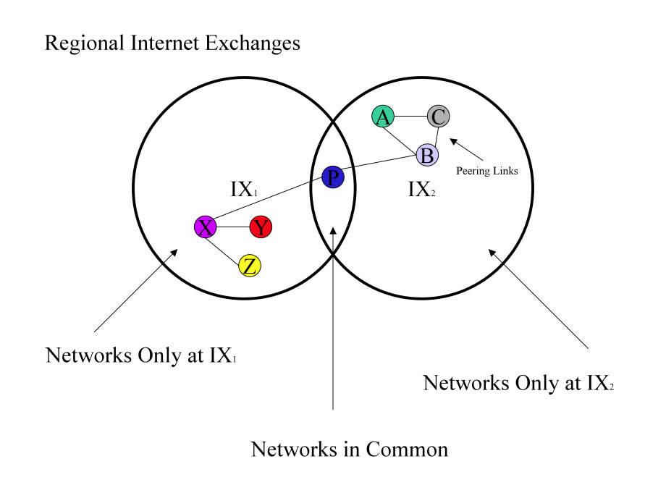
Unique Networks

Slide 16
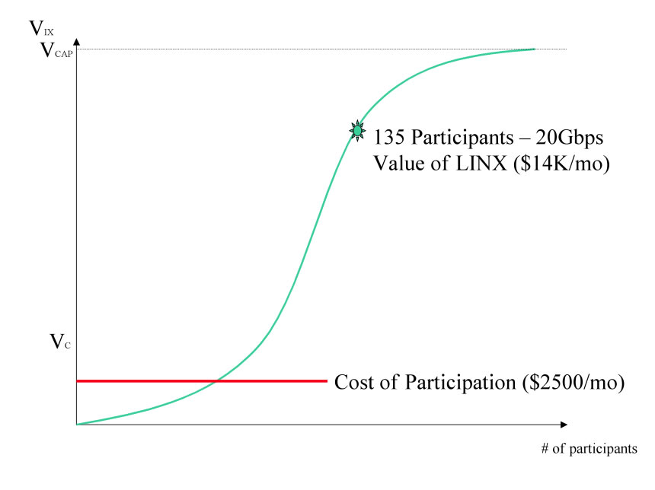
Value of LINX 135

